Slide 1
Natural History of Idiopathic Nephrotic Syndrome:
The UK National RaDaR Idiopathic Nephrotic Syndrome Cohort
David Pitcher,¹ Jonathan Barratt,² Fiona Braddon,¹ Wu Gong,³ Bruce Hendry,³ Alex Mercer,⁴ Kate Osmaston,¹ Retha Steenkamp,¹ A. Neil Turner,⁵ Daniel P. Gale,^{1,6} Moin A. Saleem⁷
¹UK Kidney Association, Bristol, UK; ²University of Leicester & Leicester General Hospital, Leicester, UK; ³Travere Therapeutics, Inc., San Diego, CA, USA; ⁴JAMCO Pharma Consulting, Stockholm, Sweden; ⁵University of Edinburgh, Centre for Inflammation, Edinburgh, UK; ⁶Royal Free Hospital, London, UK; ⁷University of Bristol & Bristol Royal Hospital for Children, Bristol, UK
Contact information:
David Pitcher, david.pitcher@renalregistry.nhs.org

Slide 2
Introduction and Methods
Idiopathic nephrotic syndrome (INS) is an important class of proteinuric kidney disease leading to kidney failure (KF)
Here we describe the natural history of INS, including genetic nephrotic syndrome, using the UK National Registry of Rare Kidney Disease (RaDaR) INS Cohort
4610 Patients with NS not attributable to glomerulonephritis or systemic disorders
4066 Eligible patients with
≥12 months of follow-up and no KF* at disease onset
INS with a genetic diagnosis
(n=105)
Biopsy-proven FSGS†
(n=1303)
Biopsy-proven MCD†
(n=1153)
INS with no genetic or biopsy diagnosis
(n=1550)
MCD progressing to FSGS†
(n=45)
Outcomes
  Time-averaged proteinuria‡
  eGFR slope‡
  KF or death§
eGFR, estimated glomerular filtration rate; FSGS, focal segmental glomerulosclerosis; MCD, minimal change disease; NS, nephrotic syndrome.
* KF was defined as stage 5 chronic kidney disease or on renal replacement therapy at or prior to disease onset. † Patients with a biopsy-proven MCD and subsequent biopsy-proven FSGS diagnosis are counted in the biopsy-proven MCD, biopsy-proven FSGS, and MCD progressing to FSGS categories. ‡ Calculated over the full duration of follow-up or until KF. §Calculated from disease onset to KF or death and censored at last follow-up.

Slide 3
Characteristics at Disease Onset
In total, 4066 patients (including 1599 children [39%]) were included, with a median age at disease onset* of 28 years
Characteristic | INS with a genetic diagnosis (n=105) | Biopsy-proven FSGS (n=1303) | Biopsy-proven MCD (n=1153) | INS with no genetic or biopsy diagnosis (n=1550) | MCD progressing to FSGS (n=45)
Age at disease onset
Median (Q1, Q3), years | 0.4 (0.1, 7.5) | 35.5 (15.3, 53.4) | 34.6 (13.3, 54.6) | 13.6 (3.8, 45.9) | 20.3 (4.9, 37.9)
<18 years at disease onset, n (%) | 86 (82) | 356 (27) | 342 (30) | 836 (54) | 21 (47)
Female sex, n (%) | 53 (50) | 552 (42) | 519 (45) | 639 (41) | 19 (42)
Race, n (%)
Asian | 26 (25) | 142 (11) | 158 (14) | 192 (12) | 6 (13)
White | 59 (56) | 920 (71) | 812 (70) | 888 (57) | 14 (74)
Other/missing/not stated | 20 (19) | 241 (18) | 183 (16) | 470 (30) | 7 (16)
UPCR at disease onset, n† | 26 | 336 | 323 | 254 | 16
Median (Q1, Q3), g/g | 28.5 (6.6, 37.8) | 5.7 (2.9, 9.5) | 6.6 (3.4, 10.3) | 6.9 (3.1, 12.7) | 5.0 (1.9, 10.5)
Serum albumin at disease onset, n† | 52 | 529 | 485 | 478 | 20
Median (Q1, Q3), g/L | 15 (10, 27) | 26 (19, 34) | 21 (15, 29) | 26 (17, 38) | 21 (17, 29)
eGFR at disease onset, n† | 32 | 439 | 375 | 317 | 17
Mean (SD), mL/min/1.73 m² | 96 (62) | 71 (41) | 84 (38) | 84 (45) | 77 (32)
Length of follow-up
Median (Q1, Q3), years | 4.1 (2.1, 8.6) | 7.4 (2.7, 13.1) | 9.1 (5.4, 14.6) | 8.3 (5.0, 12.6) | 9.7 (3.8, 16.7)
eGFR, estimated glomerular filtration rate; FSGS, focal segmental glomerulosclerosis; INS, idiopathic nephrotic syndrome; MCD, minimal change disease; SD, standard deviation; UPCR, urine protein-to-creatinine ratio.
* Disease onset date was defined as the first database occurrence of kidney biopsy, primary diagnosis, or UPCR of ≥1.5 g/g. † Number of patients with available data.

Slide 4
Proteinuria and Annual Rate of eGFR Loss
Time-Averaged Proteinuria (All Ages)
Annual Rate of eGFR Loss (All Ages)
‒2.3 (9.9)
‒3.3 (15.1)
‒6.5 (15.6)
‒8.1 (14.0)
20.3 (28)
Total time-averaged proteinuria, mean (SD), g/g
eGFR total slope, mean (SD), mL/min/1.73 m²/year
6.3 (9.2)
‒27.6 (34.7)
3.6 (5.5)
2.2 (6.5)
2.8 (10.8)
INS with a
genetic diagnosis
Biopsy-proven FSGS
Biopsy-proven MCD
INS with no genetic or biopsy diagnosis
MCD
progressing
to FSGS
INS with a
genetic diagnosis
Biopsy-proven FSGS
Biopsy-proven MCD
INS with no genetic or biopsy diagnosis
MCD
progressing
to FSGS
(n=55)
(n=809)
(n=823)
(n=39)
(n=65)
(n=835)
(n=849)
(n=40)
(n=864)
(n=851)
Mean time-averaged proteinuria was greater in children than adults (5.0 vs 1.9 g/g)
The annual rate of eGFR loss was greater in children than adults (‒7.4 vs ‒ 3.1 mL/min/1.73 m²/year) and varied by underlying cause or histological pattern
eGFR, estimated glomerular filtration rate; FSGS, focal segmental glomerulosclerosis; INS, idiopathic nephrotic syndrome; MCD, minimal change disease; SD, standard deviation.

Slide 5
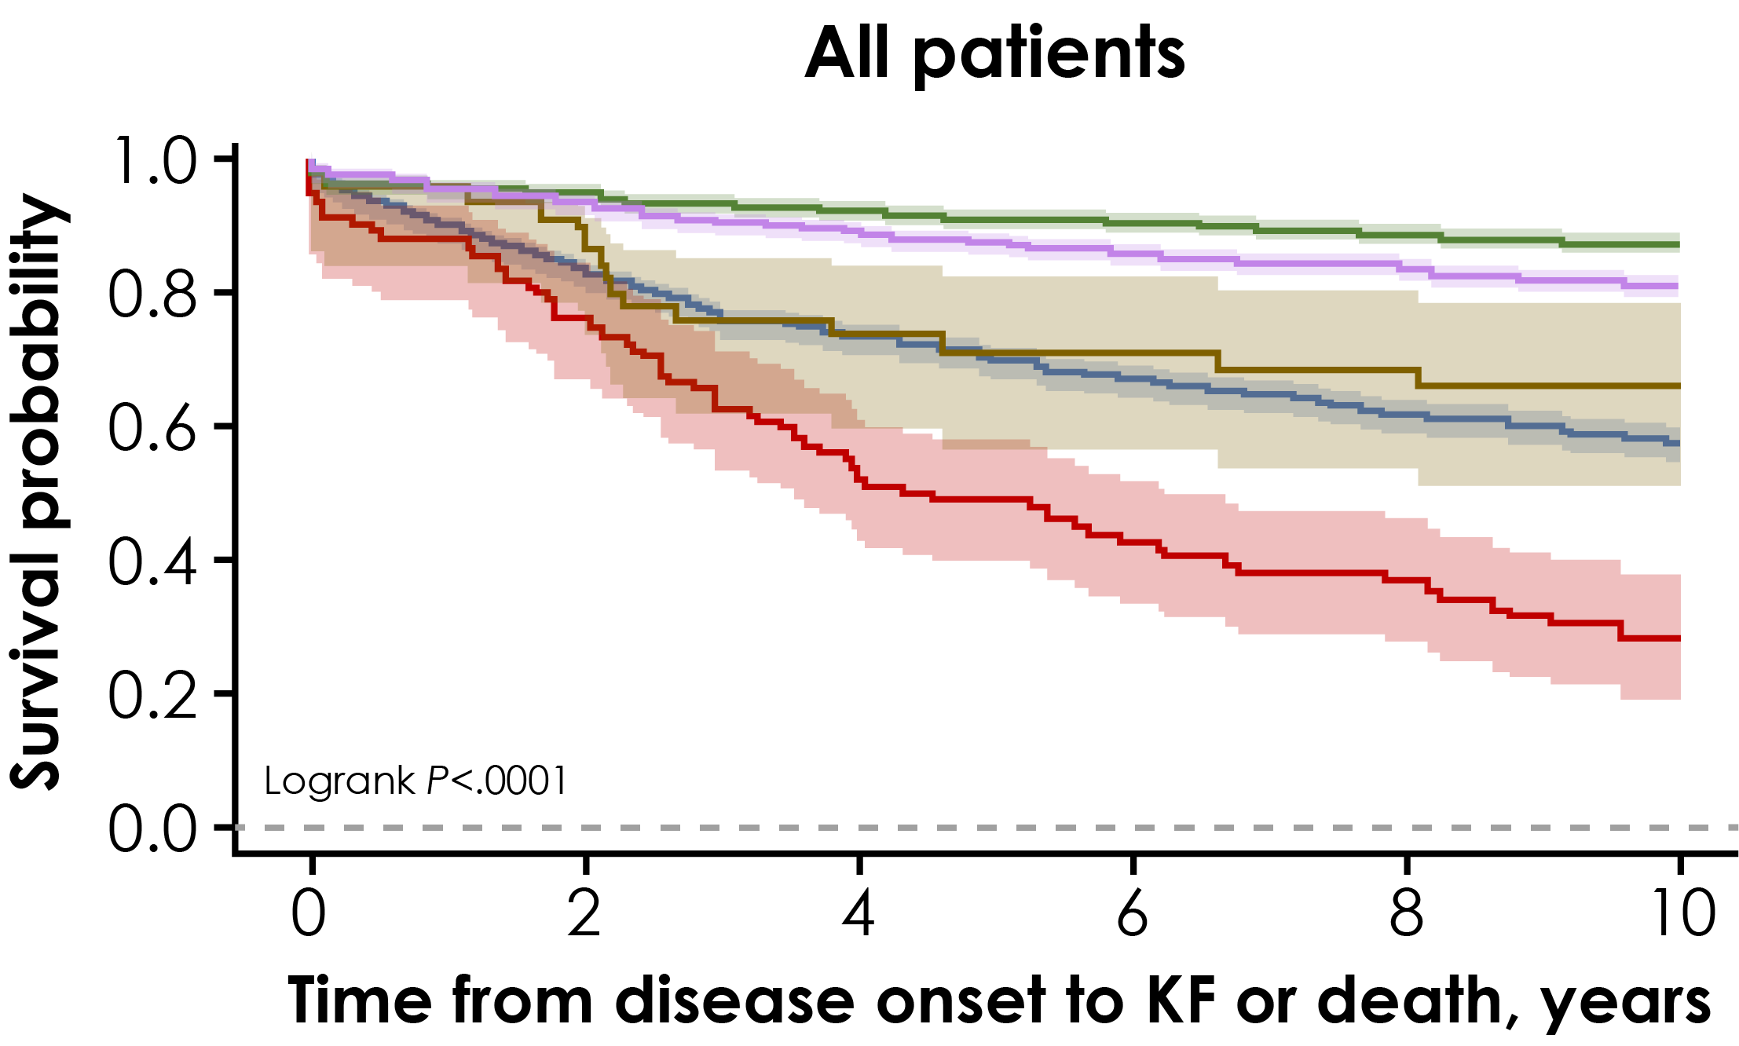
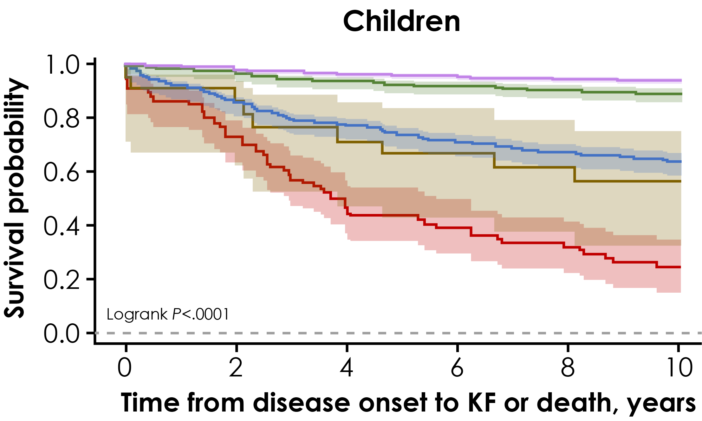
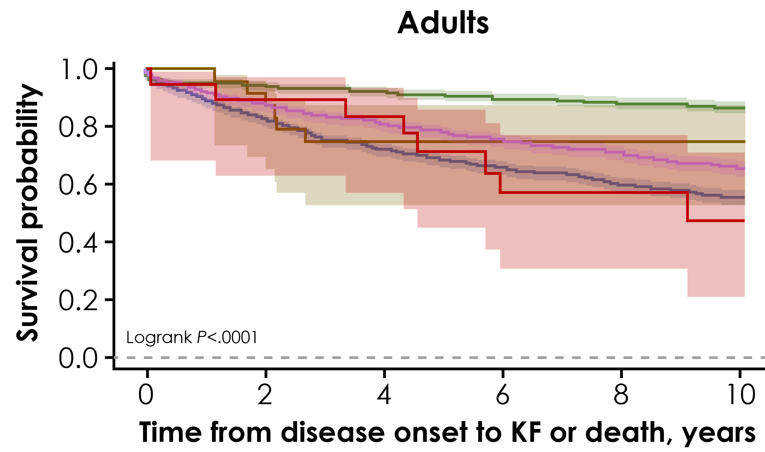

Time to Kidney Failure or Death
  Over a median follow-up duration of 8.2 years, KF or death occurred in 30% of patients
  Survival probability was generally poor for patients with INS, particularly those with a genetic diagnosis or biopsy-proven FSGS
Survival Probability Over Time
Log-rank P<0.0001
Log-rank P<0.0001
Log-rank P<0.0001
All patients | 10-year survival rate (95% CI)
INS with a genetic diagnosis (n=105) | 0.29 (0.20-0.38)
Biopsy-proven FSGS (n=1303) | 0.58 (0.55-0.61)
Biopsy-proven MCD (n=1153) | 0.87 (0.85-0.89)
INS with no genetic or biopsy diagnosis (n=1550) | 0.81 (0.78-0.83)
MCD progressing to FSGS (n=45) | 0.66 (0.50-0.78)
Children | 10-year survival rate (95% CI)
INS with a genetic diagnosis (n=86) | 0.25 (0.16-0.35)
Biopsy-proven FSGS (n=356) | 0.64 (0.58-0.69)
Biopsy-proven MCD (n=342) | 0.89 (0.85-0.92)
INS with no genetic or biopsy diagnosis (n=836) | 0.94 (0.92-0.95)
MCD progressing to FSGS (n=21) | 0.56 (0.33-0.75)
Adults | 10-year survival rate (95% CI)
INS with a genetic diagnosis (n=19) | 0.48 (0.21-0.71)
Biopsy-proven FSGS (n=947) | 0.55 (0.52-0.59)
Biopsy-proven MCD (n=811) | 0.87 (0.84-0.89)
INS with no genetic or biopsy diagnosis (n=714) | 0.65 (0.61-0.69)
MCD progressing to FSGS (n=24) | 0.75 (0.53-0.88)
Time from disease onset to KF or death
10-year survival rate
0.21 to 0.40 | 0.41 to 0.60 | 0.61 to 0.80 | 0.81 to 1.0
CI, confidence interval; FSGS, focal segmental glomerulosclerosis; INS, idiopathic nephrotic syndrome; KF, kidney failure; MCD, minimal change disease.

Slide 6



Conclusion
In a large cohort of patients with INS, 10-year kidney survival/death rates ranged from 29% for genetic INS to 58% for biopsy-proven FSGS and 87% for MCD
The disease burden in these populations highlight an unmet need for effective treatments for patients with nephrotic syndrome and FSGS
Acknowledgments
Disclosure
This study is funded by Travere Therapeutics, Inc. Medical writing support was provided by Nucleus Global, an Inizio company, and was funded by Travere Therapeutics, Inc.
DP has nothing to disclose.
To obtain a PDF of this presentation, please scan the Quick Response (QR) code. No personal information is stored.
FSGS, focal segmental glomerulosclerosis; INS, idiopathic nephrotic syndrome; MCD, minimal change disease.

