Slide 1

Sparsentan has direct effects on the glomerular capillary wall to attenuate increased permeability after exposure to nephrotic syndrome plasma
Michael Crompton, Judy J. Watson, Elizabeth Colby, Wilmelenne Clapper, Celia P. Jenkinson, Bruce Hendry, Radko Komers, Moin A. Saleem, Gavin I. Welsh, Rebecca R. Foster, Simon C. Satchell
Bristol Renal, Bristol Heart Institute, Translational Health Science,
University of Bristol, BS1 3NY
Notes:
Good afternoon, I’m Michael Crompton and I work at Bristol Renal.
Many thanks for the opportunity to present at this meeting.
Today I will be presenting my current research on how sparsentan has direct effects on the glomerular capillary wall to attenuate increased permeability after exposure to nephrotic syndrome plasma

Slide 2
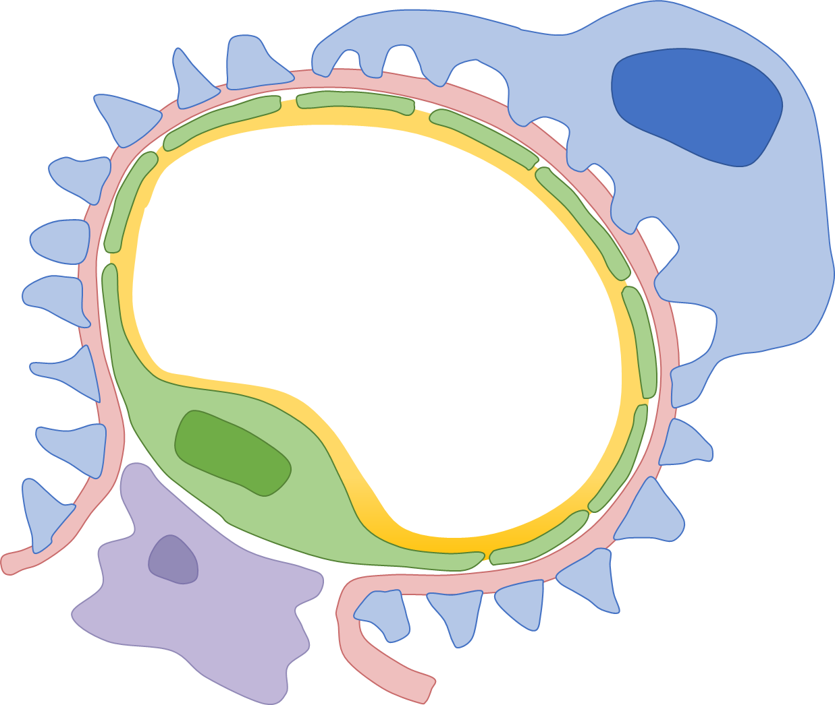
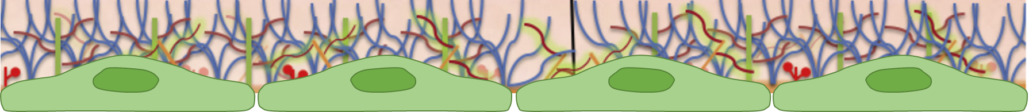
Endothelin type A (ET_{A}R) and angiotensin II type 1 (AT₁R) receptors may regulate glomerular endothelial glycocalyx (eGlx)
ET-1
ET_{A}R
Podocyte
ANG II
AT₁R
Endothelial
cell
eGlx
Glycocalyx
ET-1, endothelin 1
ANG II, angiotensin II
Endothelial cells
Daehn et al., 2014, PMID: 24590287; Ebefors et al., 2019, PMID: 31402170;
Kuwabara et al., 2010, PMID: 20526760; Crompton et al., 2023, PMID: 36749631
Notes:
The glomerular endothelial glycocalyx (eGlx), a luminal layer of proteoglycans, glycoproteins and glycolipids, forms the first part of the glomerular filtration barrier (GFB)
Nephrotic syndrome (NS) describes a group of pathologies of the renal glomerulus that result in proteinuria and is associated with glomerular endothelial dysfunction.
NS is associated with ET1 release by podocytes, causing glomerular endothelial dysfunction that precedes podocyte loss [1, 2]
ET1/ETAR mediates glomerular endothelial degradation, including eGlx damage, via podocyte-endothelial crosstalk [2]
It has been suggested that angiotensin receptor blocker (irbesartan) can reverse glomerular glycocalyx degradation seen in Zucker fatty rats.
We have shown that mineralocorticoid receptor stimulation, an end result of renin angiotensin system activation, does cause glomerular endothelial glycocalyx damage.

Slide 3
Sparsentan is a single molecule, dual ET_{A}R and AT₁R antagonist and therefore has potential to protect glomerular eGlx
Sparsentan
Sparsentan
Approved in US and EU for the reduction of proteinuria in adults with IgA nephropathy*
Under clinical development for FSGS
ET-1
ET_{A}R
Podocyte
Sparsentan
ANG II
AT₁R
Endothelial
cell
eGlx
ET-1, endothelin 1
ANG II, angiotensin II
*accelerated approval in US; conditional approval in EU
Notes:
Sparsentan is a single molecule that functions as a high-affinity, dual-acting antagonist of both endothelin receptor type A (ETA) and angiotensin II receptor type 1 (AT1)
Approved in US and EU for the reduction of proteinuria in adults with IgA nephropathy
Under clinical development for FSGS

Slide 4

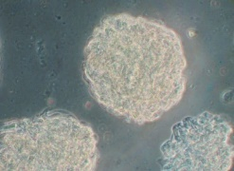
AIM: Can sparsentan protect the eGlx and maintain the glomerular filtration barrier in rat glomeruli exposed to human nephrotic syndrome (NS) plasma?
*
Patient 1
Patient 2
Patient 3
Paired relapse/remission
human NS plasma
Relapse
Remission
Isolated
glomeruli
10% human NS plasma
Relapse or Remission
Glomerular permeability assay
Fixed glomeruli for staining
male Sprague Dawley (150-200g)
Vehicle or Sparsentan
1 hour
Mean ± SEM; *, p < 0.05
Notes:
Here we sought to determine whether sparsentan could protect the eGlx and maintain the glomerular filtration barrier in rat glomeruli exposed to human nephrotic syndrome (NS) plasma
Human NS plasma samples were collected under ethical consent from 3 patients that had undergone plasma exchange from periods when they were in relapse (RL), or subsequent remission (RM).
Adult male Sprague Dawley rats (175-200 g) were perfused with 4% Ringer BSA solution.
Glomeruli were isolated on ice by graded sieving from the cortex of each kidney. Glomeruli were incubated with 10% plasma from NS patients for 1 hour, and simultaneously treated with sparsentan or vehicle.

Slide 5
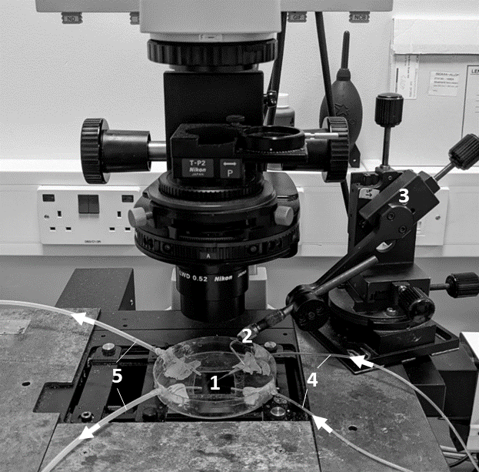
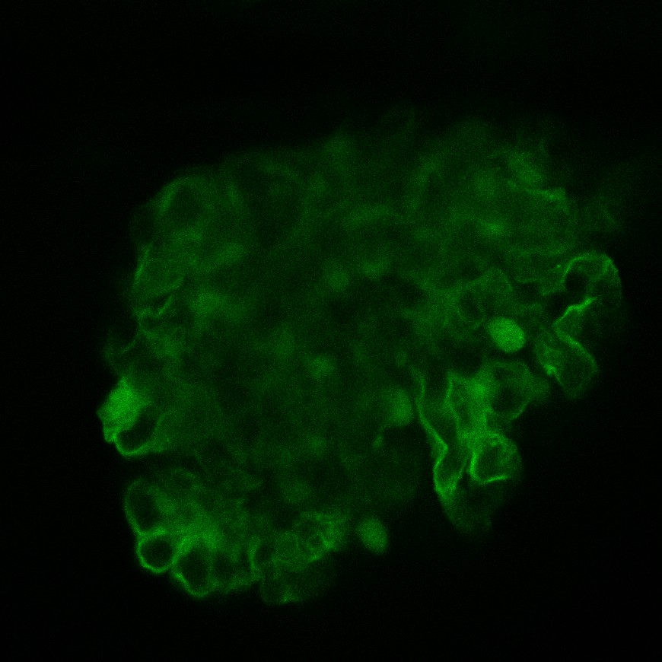
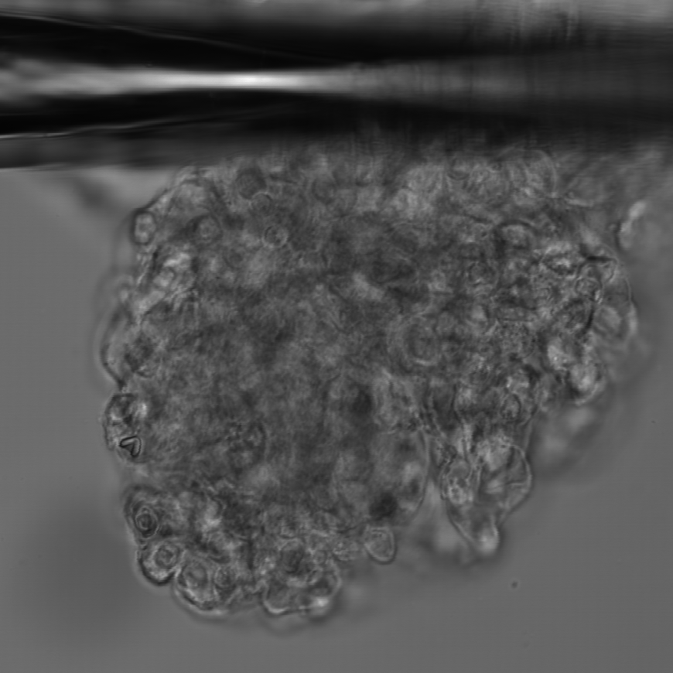
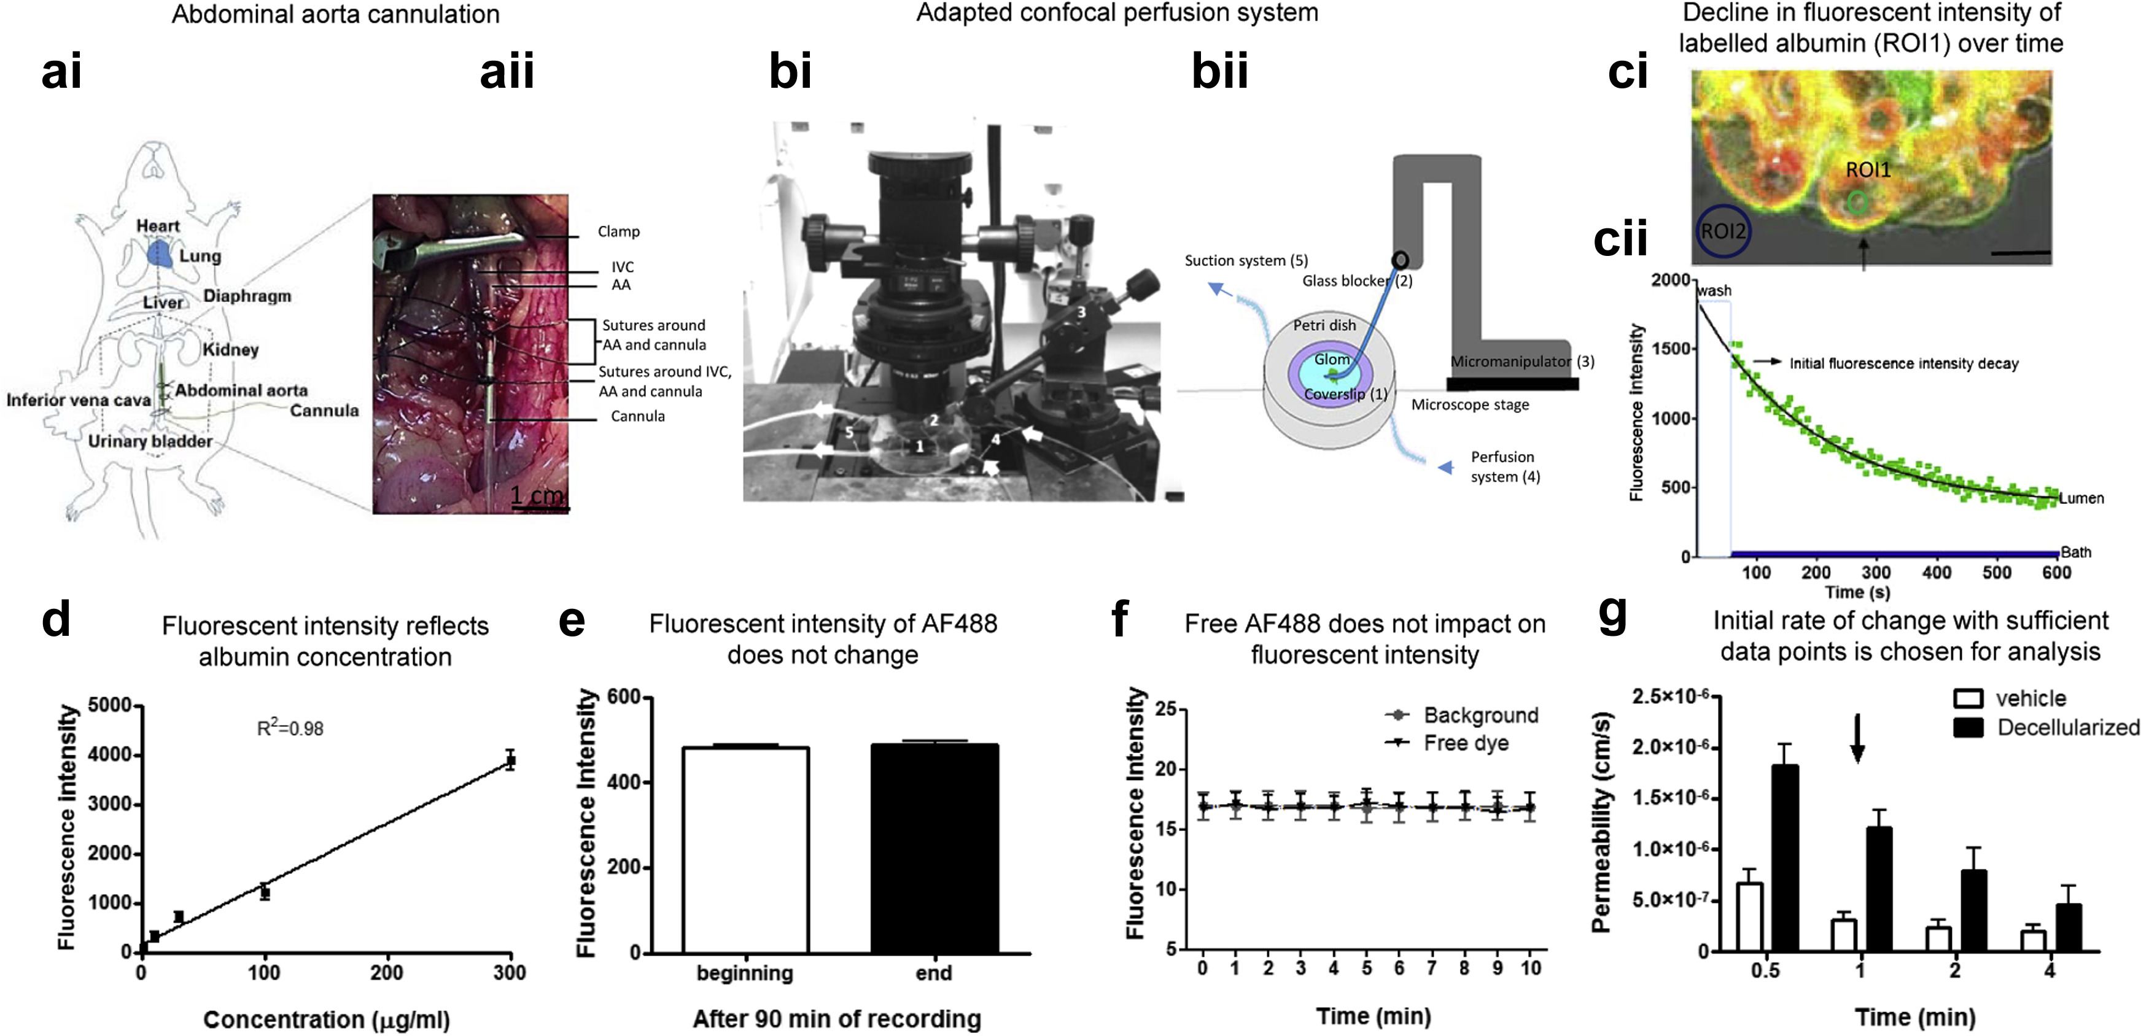
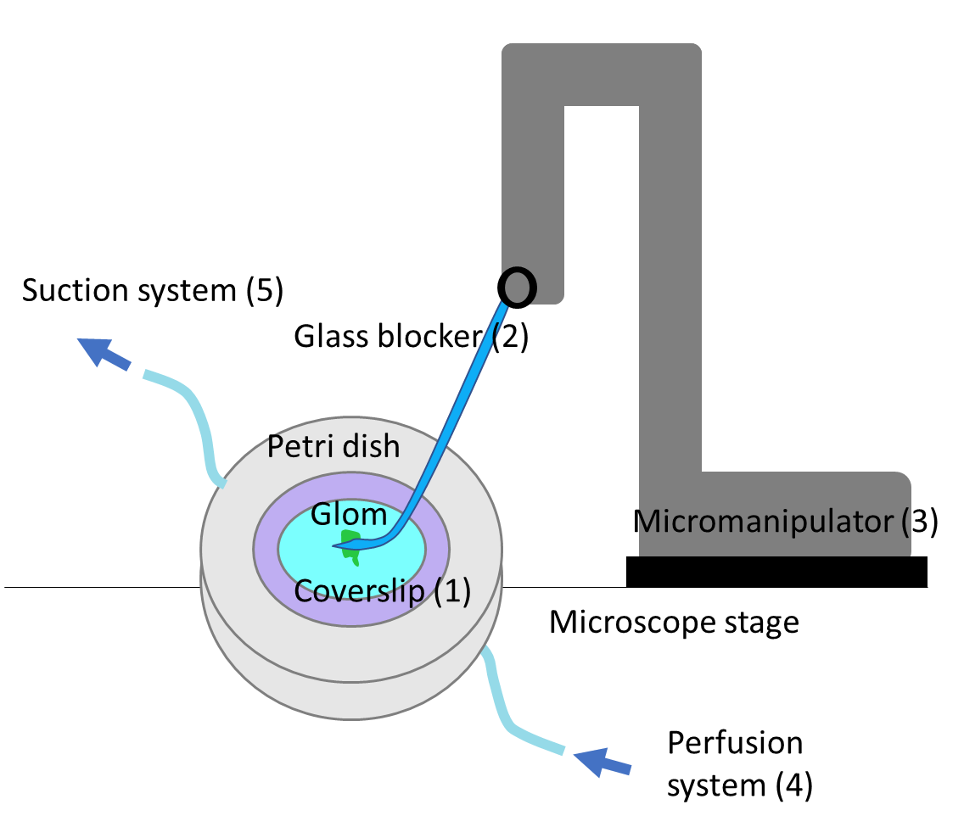
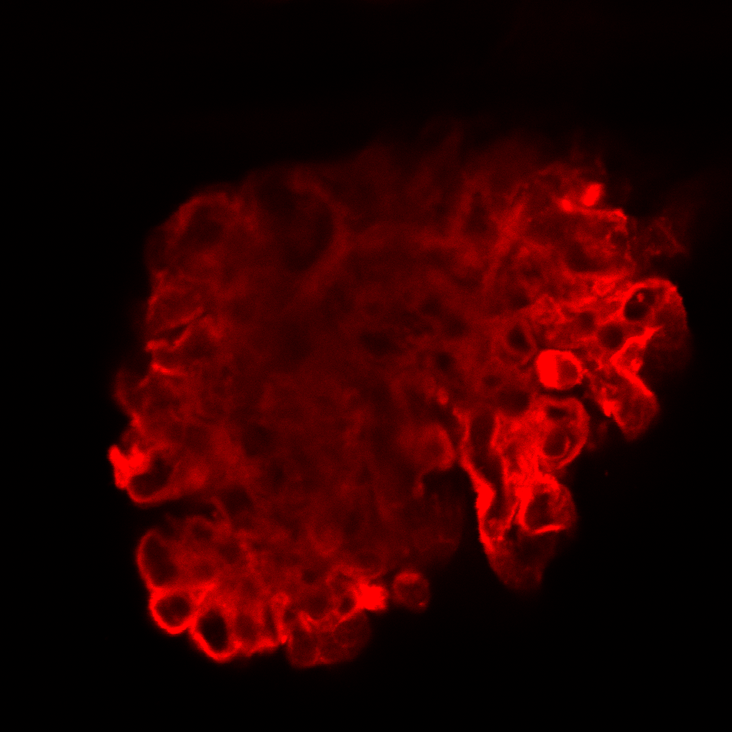
Our validated glomerular permeability assay directly measures the albumin permeability (Ps’_{alb}) of capillary loops within individually trapped glomeruli
AF488-BSA
Decline in fluorescence intensity of labelled albumin (ROI1) over time
R18
2000
1500
1000
500
0
wash
Fluorescecne Instensity
Initial fluorescence intensity decay
Lumen
Bath
100 200 300 400 500 600
Time (s)
Desideri et al., 2018, PMID: 29433915
Notes:
Our glomerular permeability assay was used to directly measure the albumin permeability of individually trapped glomeruli.
In contrast to urine-based measurements, this ex vivo assay directly measures the GFB permeability to albumin in isolation, independently of hemodynamic factors and tubular albumin handling.
An individual glomerulus was trapped and the perfusate was switched from labeled 488-BSA to unlabeled BSA. A confocal microscope was used to capture the fluorescence intensity.
The rate of decline in fluorescence intensity within the loop of the capillaries was used to calculate albumin permeability.

Slide 6
Human NS plasma increased glomerular albumin permeability in rat glomeruli
Ps’_{alb} (cm/s)
Patient 1
Patient 2
Patient 3
Relapse
3(11)
Remission
3(13)
Relapse
3(12)
Remission
3(11)
Relapse
3(13)
Remission
3(9)
Vehicle
Ps’_{alb}, albumin permeability. # of animals (# of glomeruli). Mean ± SEM; **, p < 0.01; ***, p < 0.001
Notes:
Incubation of rat glomeruli with RL plasma induced a significant increase in Ps’_{alb} compared to rat glomeruli incubated with paired RM plasma

Slide 7
Human NS plasma increased glomerular albumin permeability in rat glomeruli
Patient 1
Patient 2
Patient 3
Ps’_{alb} (cm/s)
Ps’_{alb} (cm/s)
Patient 1
Patient 2
Patient 3
Relapse
Remission
Relapse
3(11)
Remission
3(13)
Relapse
3(12)
Remission
3(11)
Relapse
3(13)
Remission
3(9)
Vehicle
Vehicle
Ps’_{alb}, albumin permeability. # of animals (# of glomeruli). Mean ± SEM; **, p < 0.01; ***, p < 0.001
Notes:
Incubation of rat glomeruli with RL plasma induced a significant increase in Ps’_{alb} compared to rat glomeruli incubated with paired RM plasma

Slide 8
Sparsentan dose-dependently protected against increased glomerular albumin permeability resulting from human NS plasma
Patient 1
Patient 2
Patient 3
Ps’_{alb} (cm/s)
Vehicle
Vehicle
Sparsentan
0.1 µM
Sparsentan
1 µM
Sparsentan
10 µM
Remission
Relapse
Mean ± SEM; *, p < 0.05; **, p < 0.01; ***, p < 0.001. +, P-value vs. Remission+Vehicle
Notes:
Sparsentan-treated RL incubated glomeruli were protected from the increase in Ps’_{alb}, to a level comparable to RM incubated glomeruli.
The effect of sparsentan on Ps’_{alb} was dose dependent

Slide 9
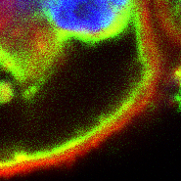
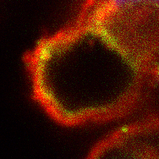
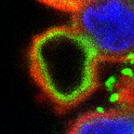
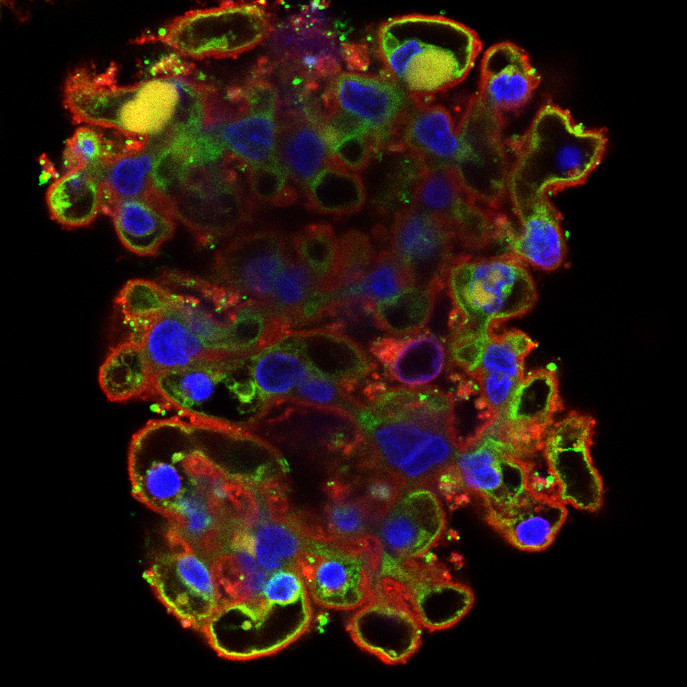
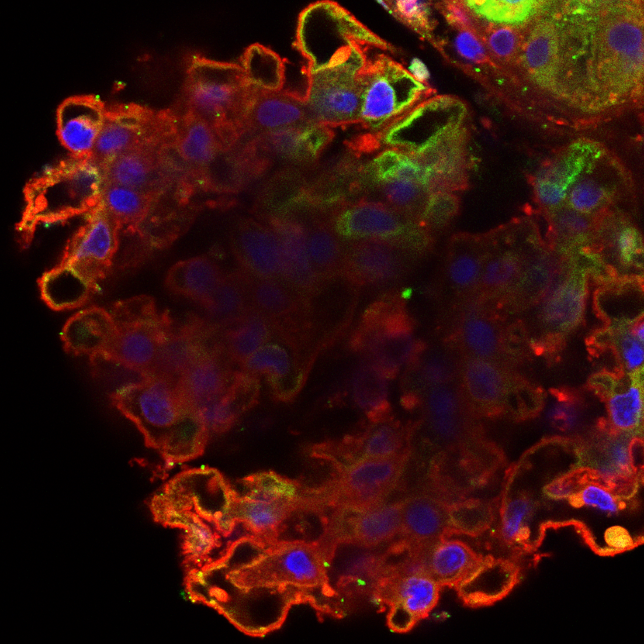
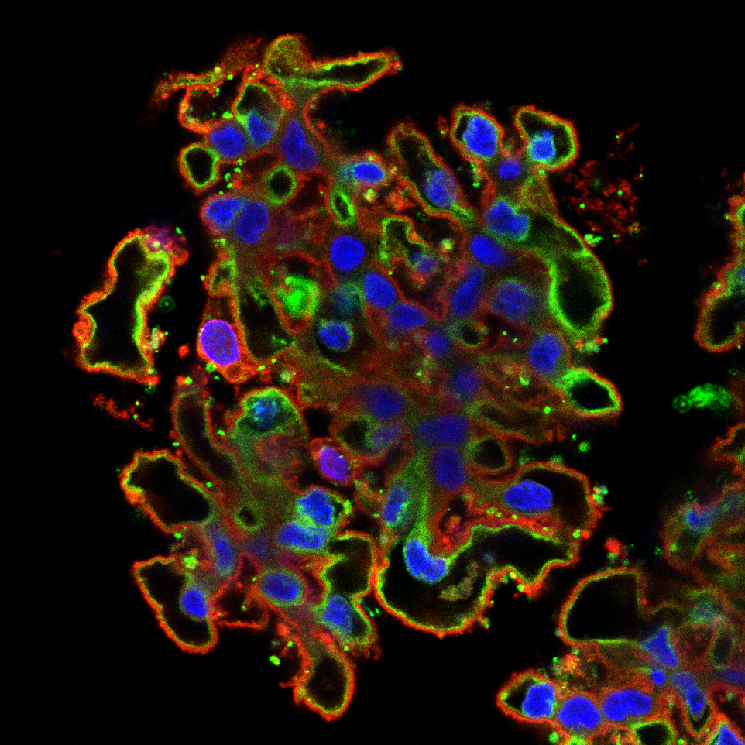
Sparsentan prevented eGlx damage in rat glomeruli exposed to human NS plasma
Remission + Vehicle
Relapse + Vehicle
Relapse + Sparsentan (10 µM)
LEL
R18
DAPI
LEL (Lycopersicon esculentum Lectin) - luminal glomerular eGlx
R18 (Octadecyl Rhodamine B Chloride) – cell membrane label
DAPI – nuclear label
Scale bar = 10 µm
Notes:
Here we have a confocal image of a rat glomerulus.
Lectin in green, cell membranes including the luminal EnC membrane in red and nuclei in blue
MAL I lectin in green bound to the EnGlx on the luminal surface of the GEnC membrane, which was labelled with R18.

Slide 10
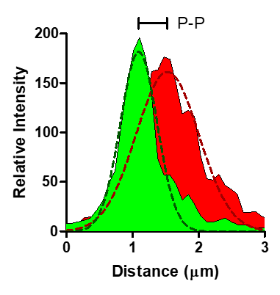
Sparsentan dose-dependently prevented eGlx damage in rat glomeruli exposed to human NS plasma
Remission + Vehicle
Relapse + Vehicle
Relapse + Sparsentan (10 µM)
LEL
R18
DAPI
Peak-to-Peak → Glx thickness
Green – eGlx
Red - cell membrane
Vehicle
Vehicle
Sparsentan
0.1 µM
Sparsentan
1 µM
Sparsentan
10 µM
Remission
Relapse
Mean ± SEM; *, p < 0.05
Notes:
The confocal images generated were analysed using a fluorescent profile peak-to-peak measurement technique to provide an index of GEnGlx thickness.
Quantification of the MAL I lectin peak-to-peak showed significant glycocalyx damage, with a decrease in GEnGlx thickness.
Sparsentan dose-dependently prevented eGlx damage

Slide 11
The effect of sparsentan in preventing the NS-induced increase in glomerular permeability is correlated with protection from eGlx loss
Remission + Vehicle
Relapse + Vehicle
Relapse + Sparsentan (10 µM)
r² = 0.8342
P-value = < 0.0001
LEL
R18
DAPI
Ps’_{alb} (cm/s)
Peak-to-Peak → Glx thickness
Green – eGlx
Red - cell membrane
Remission + Vehicle
Relapse + Vehicle
Relapse + Sparsentan (10 µM)
Relapse + Sparsentan (1 µM)
Relapse + Sparsentan (0.1 µM)
Notes:
The effect of sparsentan in preventing the NS-induced increase in glomerular permeability is correlated with protection from eGlx loss

Slide 12
Sparsentan preserved glomerular eGlx and protected glomeruli from increased permeability following exposure to human NS plasma
Sparsentan
SUMMARY
Dual antagonism of ET_{A}R and AT₁R, with sparsentan, preserved the glomerular eGlx resulting in normalised glomerular permeability following incubation with NS plasma
The direct action of sparsentan on the GFB could help maintain barrier integrity in NS, via glycocalyx protection
ET-1
ET_{A}R
Podocyte
Sparsentan
ANG II
AT₁R
Endothelial
cell
eGlx
Notes:
We have shown that dual inhibition of endothelin and angiotensin receptors, with sparsentan, preserves the glomerular eGlx resulting in normalised glomerular permeability in NS.
These findings suggest that the direct action of sparsentan on the GFB could help maintain barrier integrity in NS, in particular by glycocalyx protection.

Slide 13

Acknowledgements
This work was funded by Travere Therapeutics, Inc.
Judy J. Watson
Elizabeth Colby
Moin A. Saleem
Gavin I. Welsh
Rebecca R. Foster
Simon C. Satchell
Bristol Renal
Wolfson Bioimaging Facility
Wilmelenne Clapper
Celia P. Jenkinson
Bruce Hendry
Radko Komers
To obtain a PDF of this presentation, please scan the Quick Response (QR) code. No personal information is stored.
m.crompton@bristol.ac.uk
Notes:
Thank you to everyone that has contributed to this research, and I’d be happy to take some questions.

