Slide 1
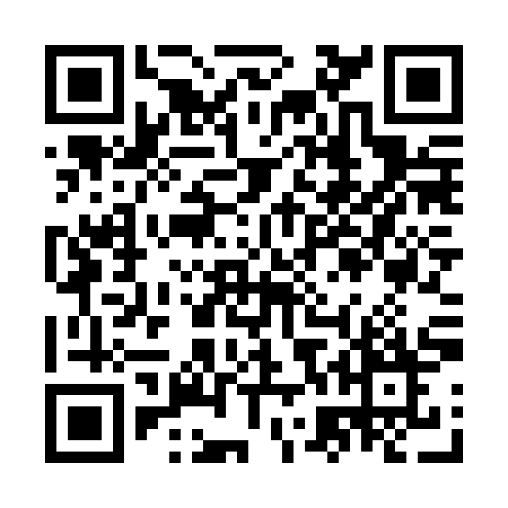

Concomitant Sparsentan and Sodium-Glucose Cotransporter-2 Inhibitors (SGLT2is) in Patients With IgA Nephropathy (IgAN) in the PROTECT Open-Label Extension (OLE)
Poster WCN24-AB-752
Priscila Preciado,¹ Laura Kooienga,² Robert Malecki,³
Alex Mercer,⁴ Nuhira Ahmed Masthan Ahmed⁵
Presenter: Radko Komers¹
¹Clinical Development, Nephrology, Travere Therapeutics, Inc., San Diego, CA, USA;
²Research Division, Colorado Kidney Care, Denver, CO, USA; ³Department of Nephrology, Międzyleski Specialist Hospital, Warsaw, Poland; ⁴JAMCO Pharma Consulting, Stockholm, Sweden; ⁵Biostatistics, Travere Therapeutics, Inc., San Diego, CA, USA
April 2024. MA-SP-24-0031.
Contact information:
Priscila Preciado, priscila.preciado@travere.com
Presented at the World Congress of Nephrology (WCN) 2024;
April 13-16, 2024; Buenos Aires, Argentina

Slide 2
PP and NAMA are employees of Travere Therapeutics, Inc., and may have equity or other financial interests in Travere Therapeutics, Inc.
LK is the PI for sponsor studies from Akebia Therapeutics, AstraZeneca, Boehringer Ingelheim, CARA Therapeutics, Chinook Therapeutics, CSL Behring, Galderma, Omeros, Otsuka, Reata Pharmaceuticals, Sanifit, Travere Therapeutics, Inc., and Visterra
RM has received speaker’s honoraria from AstraZeneca, Bayer, Berlin-Chemie Menarini, Boehringer Ingelheim, Fresenius Kabi, Novartis, Novo Nordisk and Lilly and travel support from Aurovitas Pharma and Menarini
AM has received consultancy fees from Travere Therapeutics, Inc.
These data were previously presented at the American Society of Nephrology (ASN) Kidney Week 2023; November 2-5 2023; Philadelphia, PA, USA.
Preciado P, et al. Poster presented at WCN 2024; April 13-16, 2024; Buenos Aires, Argentina. Poster WCN24-AB-752.
April 2024. MA-SP-24-0031.

Slide 3
Sparsentan is a nonimmunosuppressive, single-molecule, dual endothelin angiotensin receptor antagonist (DEARA)¹⁻³
In the ongoing PROTECT trial, sparsentan was directly compared with irbesartan in patients with IgAN.⁴ Based on results from this trial, sparsentan was granted accelerated approval in the US for adults with primary IgAN at risk of rapid disease progression⁵
Subgroup analyses from DAPA-CKD and EMPA-KIDNEY suggest that SGLT2is may reduce the progression of IgAN.^{6,7} An SGLT2i plus DEARA combination therapy may provide additional kidney-protective effects, although the adverse events (AEs) with this combination therapy are unknown
Here we report the early clinical experience of patients with IgAN enrolled in the PROTECT OLE who received an SGLT2i in addition to their ongoing sparsentan treatment
Preciado P, et al. Poster presented at WCN 2024; April 13-16, 2024; Buenos Aires, Argentina. Poster WCN24-AB-752.
April 2024. MA-SP-24-0031.

Slide 4
The PROTECT OLE study will investigate the long-term efficacy, safety, and tolerability of sparsentan treatment in adult patients with IgAN
  This analysis will assess the safety and efficacy in a subset of patients within the PROTECT OLE period who chose to add SGLT2i treatment to their ongoing sparsentan treatment
Preciado P, et al. Poster presented at WCN 2024; April 13-16, 2024; Buenos Aires, Argentina. Poster WCN24-AB-752.
April 2024. MA-SP-24-0031.

Slide 5
Study Design
Patients who completed the PROTECT double-blind period and met eligibility criteria were enrolled in the PROTECT OLE (NCT03762850)
All patients in the PROTECT OLE will receive sparsentan with a target dose of 400 mg/day for up to 156 weeks
Patients could initiate concomitant SGLT2i treatment at any time during the OLE period at the discretion of the investigator
  Patients enrolled in the PROTECT OLE SGLT2i substudy, randomized (1:1) to receive sparsentan monotherapy vs sparsentan plus an SGLT2i, were excluded from this analysis
Body weight, systolic and diastolic blood pressure, and urine protein-to-creatinine ratio (based on a 24-hour urine sample) were evaluated at baseline and at weeks 12, 24, 36, and 48 after baseline
  Baseline was defined as the OLE visit closest to the SGLT2i start (ie, before or <14 days after)
Treatment-emergent adverse events (TEAEs) were determined
Preciado P, et al. Poster presented at WCN 2024; April 13-16, 2024; Buenos Aires, Argentina. Poster WCN24-AB-752.
April 2024. MA-SP-24-0031.

Slide 6
Eligibility Criteria
Key inclusion criteria
  Enrollment and active participation in the PROTECT OLE period while continuing sparsentan treatment
  Initiation of an SGLT2i as concomitant medication during the OLE period
Key exclusion criterion
  Enrollment in the randomized PROTECT OLE SGLT2i substudy
Statistical Analysis
Safety and efficacy endpoints were summarized using descriptive statistics for patients who received ≥1 dose of sparsentan plus an SGLT2i
Preciado P, et al. Poster presented at WCN 2024; April 13-16, 2024; Buenos Aires, Argentina. Poster WCN24-AB-752.
April 2024. MA-SP-24-0031.

Slide 7
Patient Population
At data cutoff, 39 patients had received sparsentan with concomitant SGLT2i treatment in the OLE period
  Five patients discontinued the OLE, including 2 who first discontinued SGLT2i treatment and then discontinued the OLE
    Discontinuations were due to kidney replacement therapy (n=1), physician decision (n=1), and TEAEs (n=3; aggravation of IgAN [n=1] and alanine aminotransferase elevation [n=2])
  Two patients discontinued SGLT2i treatment but are continuing to receive sparsentan treatment in the OLE (reasons for discontinuing concomitant medications were not captured)
Baseline patient demographics and clinical characteristics are reported in Table 1 and Table 2, respectively
Preciado P, et al. Poster presented at WCN 2024; April 13-16, 2024; Buenos Aires, Argentina. Poster WCN24-AB-752.
April 2024. MA-SP-24-0031.

Slide 8
Table 1. Patient Demographics
Baseline characteristic* | Patients (N=39)
Sex, n (%)
Male | 28 (72)
Female | 11 (28)
Race, n (%)
White | 25 (64)
Asian | 11 (28)
Black/African American | 2 (5)
Other | 1 (3)
Ethnicity, n (%)
Not Hispanic/Latino | 38 (97)
Hispanic/Latino | 1 (3)
Age at baseline visit, mean (SD), years | 44.2 (11.11)
OLE, open-label extension; SGLT2i, sodium-glucose cotransporter-2 inhibitor.
*Baseline was defined as the OLE visit closest to the SGLT2i start (ie, before or <14 days after).
Preciado P, et al. Poster presented at WCN 2024; April 13-16, 2024; Buenos Aires, Argentina. Poster WCN24-AB-752.
April 2024. MA-SP-24-0031.

Slide 9
Table 2. Baseline Clinical Characteristics and Medication Use
Baseline characteristic | Patients (N=39)
Clinical measurements
BMI, mean (SD), kg/m² | 28.4 (4.59)*
Body weight, mean (SD), kg | 85.4 (23.13)*
Systolic blood pressure, mean (SD), mm Hg | 126.2 (12.65)*
Diastolic blood pressure, mean (SD), mm Hg | 81.4 (9.95)*
Urine protein excretion, g/day
Mean (SD) | 2.7 (1.83)
Median (IQR) | 2.0 (1.3-4.2)
UPCR, g/g
Mean (SD) | 1.97 (1.20)
Median (IQR) | 1.77 (1.06-3.15)
eGFR, mL/min/1.73 m²
Mean (SD) | 44.9 (22.39)†
Median (IQR) | 38.0 (29.0-53.0)
History of hypertension, n (%) | 30 (77)
Antihypertensive medications at baseline visit, n (%) | 24 (62)
Diuretics | 13 (33)
β-Blockers | 11 (28)
α-Blockers | 6 (15)
Calcium channel blockers | 14 (36)
Time from start of OLE treatment to start of SGLT2i treatment, median (IQR), days | 253.0 (92.0-358.0)
BMI, body mass index; eGFR, estimated glomerular filtration rate; OLE, open-label extension; SGLT2i, sodium-glucose cotransporter-2 inhibitor;
UPCR, urine protein-to-creatinine ratio.
*n=37. †n=38.
Preciado P, et al. Poster presented at WCN 2024; April 13-16, 2024; Buenos Aires, Argentina. Poster WCN24-AB-752.
April 2024. MA-SP-24-0031.

Slide 10
Safety
Twenty-six patients (67%) had a TEAE (Table 3)
Body weight (Figure 1) and blood pressure (systolic and diastolic; Figure 2) remained relatively stable over time following the addition of an SGLT2i to sparsentan treatment
Table 3. Summary of TEAEs
TEAEs* | Patients (N=39)
Patients with any TEAE, n (%) | 26 (67)
TEAEs in >1 patient, n (%)
Hyperkalemia | 5 (13)
COVID-19 | 4 (10)
Hypertension | 3 (8)
Acute kidney injury | 2 (5)
Chronic kidney disease | 2 (5)
Headache | 2 (5)
Hypotension | 2 (5)
Peripheral edema | 2 (5)
Viral infection | 2 (5)
MedDRA, Medical Dictionary for Regulatory Activities; TEAE, treatment-emergent adverse event.
*TEAEs were based on MedDRA preferred terms.
Preciado P, et al. Poster presented at WCN 2024; April 13-16, 2024; Buenos Aires, Argentina. Poster WCN24-AB-752.
April 2024. MA-SP-24-0031.

Slide 11
Figure 1. Body Weight Over Time
n
37
28
23
16
14
OLE, open-label extension; SGLT2i, sodium-glucose cotransporter-2 inhibitor.
*Baseline was defined as the OLE visit closest to the SGLT2i start (ie, before or <14 days after start of SGLT2i treatment). Data are shown at weeks 12, 24, 36, and 48 after baseline.
Preciado P, et al. Poster presented at WCN 2024; April 13-16, 2024; Buenos Aires, Argentina. Poster WCN24-AB-752.
April 2024. MA-SP-24-0031.

Slide 12
Figure 2. Systolic and Diastolic Blood Pressure Over Time
n
37
28
23
16
14
BP, blood pressure; OLE, open-label extension; SGLT2i, sodium-glucose cotransporter-2 inhibitor.
*Baseline was defined as the OLE visit closest to the SGLT2i start (ie, before or <14 days after start of SGLT2i treatment). Data are shown at weeks 12, 24, 36, and 48 after baseline.
Preciado P, et al. Poster presented at WCN 2024; April 13-16, 2024; Buenos Aires, Argentina. Poster WCN24-AB-752.
April 2024. MA-SP-24-0031.

Slide 13
Efficacy
Combination therapy of sparsentan plus an SGLT2i led to a further reduction in proteinuria for up to 48 weeks (Figure 3)
Figure 3. UPCR Over Time
*
n
39
26
20
15
12
OLE, open-label extension; SGLT2i, sodium-glucose cotransporter-2 inhibitor; UPCR, urine protein-to-creatinine ratio.
*Baseline was defined as the OLE visit closest to the SGLT2i start (ie, before or <14 days after start of SGLT2i treatment). Data are shown at weeks 12, 24, 36, and 48 after baseline.
Preciado P, et al. Poster presented at WCN 2024; April 13-16, 2024; Buenos Aires, Argentina. Poster WCN24-AB-752.
April 2024. MA-SP-24-0031.

Slide 14
Early clinical experience of patients during the PROTECT OLE period shows that an SGLT2i added to stable sparsentan treatment is generally well tolerated
Data are consistent with an additive benefit on proteinuria reduction with combination therapy
A randomized substudy within the PROTECT OLE period is further investigating the safety and efficacy of sparsentan with or without concomitant SGLT2i treatment
Preciado P, et al. Poster presented at WCN 2024; April 13-16, 2024; Buenos Aires, Argentina. Poster WCN24-AB-752.
April 2024. MA-SP-24-0031.

Slide 15
This study is funded by Travere Therapeutics, Inc. Medical writing support was provided by Lise Barnard, PhD, Nicole Lopez, PhD, and Chris Edwards, PhD, CMPP, of Nucleus Global, an Inizio Company, and was funded by Travere Therapeutics, Inc.
Preciado P, et al. Poster presented at WCN 2024; April 13-16, 2024; Buenos Aires, Argentina. Poster WCN24-AB-752.
April 2024. MA-SP-24-0031.

Slide 16
1. Trachtman H, et al. Expert Opin Emerg Drugs. 2020;25(3):367-375.
2. Kowala MC, et al. J Pharmacol Exp Ther. 2004;309(1):275-284.
3. Nagasawa H, et al. Nephrol Dial Transplant. 2022;37:183.
4. Heerspink HJL, et al. Lancet. 2023;401(10388):1584-1594.
5. Filspari (sparsentan). Prescribing information. Travere Therapeutics, Inc.; 2023.
6. Herrington WG, et al. N Engl J Med. 2023;388(2):117-127.
7. Wheeler DC, et al. Kidney Int. 2021;100(1):215-224.
Preciado P, et al. Poster presented at WCN 2024; April 13-16, 2024; Buenos Aires, Argentina. Poster WCN24-AB-752.
April 2024. MA-SP-24-0031.

